Slide 1
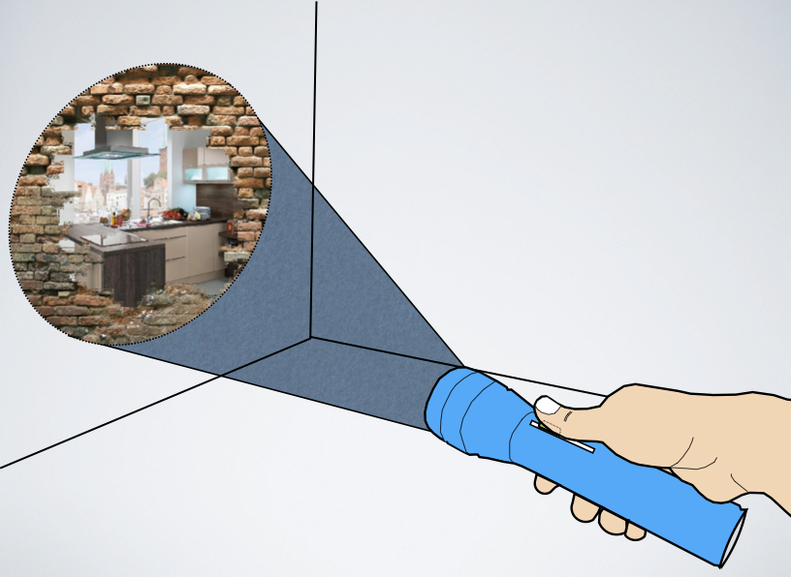


SUPERVISION
Detection and Control of In-Sight and Out of Sight Objects in a Smart Home
Date: 29/4/2014
-Sarthak Ghosh
2010A3TS211H
Supervisors: Dr. Gilles Bailly
Mr. Chetan Kumar

Slide 2
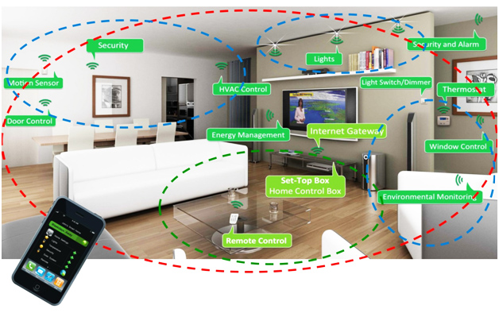
Introduction
Smart Home : Connected objects, capable of interaction with user.

Slide 3
Problem: As more and more devices become “Smart” and connected, interaction with them becomes complex.
Notes:
The video in the next slide illustrates the two types of complex interaction with objects.

Slide 4
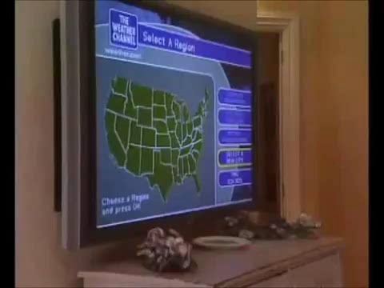
Notes:
One remote but not intuitive. Division of focus from the digital world to the physical world. Too many functionalities to handle.

Slide 5
Problem: Most of the commonly used remotes, only work for objects in the line of sight of the user. Thus they do not utilize the ability of users to remember the spatial location of objects in other rooms.
Notes:
But human beings can make a spatial map of objects in other rooms as well, in their memory and thus can

Slide 6
Objectives:
A method to select objects in the same room as the user : Similar to the currently existing methods of distal control.

Slide 7
2. A method to select objects in adjacent rooms:
So that the users utilize their spatial memory to
locate objects which are in the adjacent rooms,
and separated from the user, by a wall.

Slide 8
3. An intuitive interaction method which does
not divide the user’s focus from the object to
the remote : Lesser cognitive load on the
mind of the user, if the focus is always on the
object being controlled, and not on the
controller.

Slide 9
4. Augmenting Objects with Digital information:
Displaying information on and around objects,
using a hand-held projector.

Slide 10
5. Techniques to interact with the
objects, by pointing on a projected interface;
Quick and effective control of objects from a
distance, with immediate visual feedback.

Slide 11
Related Work
Pointing interactions
Traditional Remote Controls
Universal Remote Controls :Most Lack user interfaces[1]
Laser Pointer: Ergonomically Suited.
Prone to error (hand jitter)

Slide 12
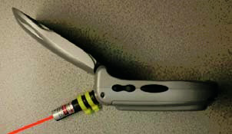
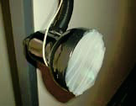
Laser Pointer Patel et. al , Springer 2003[2]
All objects are tagged.
Tags are 5-inch in diameter, containing bed of photo sensors. Thus visually obtrusive.

Slide 13
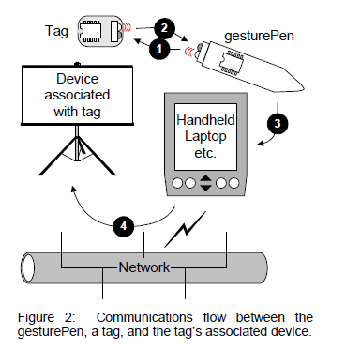
IR interaction (Swindell’s et. al[3])
IR transceivers on pointer, and objects.
Information transferred through IR.
Problem of limited range of IR, and multiple selections due to wide angled IR beams.

Slide 14
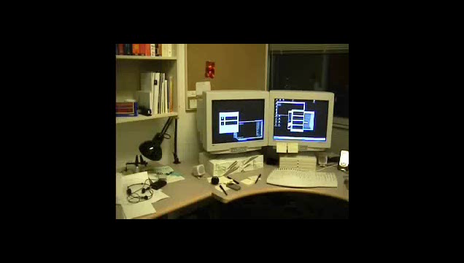
Xwand ( Wilson et. al, [4])
Pointer is continuously tracked
Machine learning is used to identify objects being pointed at
No use of interaction interface
Only static environments supported

Slide 15
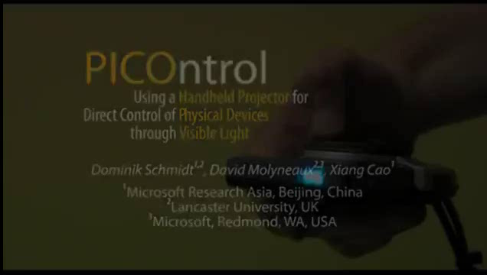
Hand held Projector Systems
PICOntrol (Schmidt et. al, [5])
-Hand held projector for pointing.
-Light sensors on objects as receivers.
-Commands passed as visible light patterns from the projector
-Problems of multiple selections when object density is high
-
Notes:
Using a handheld pico-projector to both display an interface and transmit commands.
No central networking of devices involved
Direct interaction, no division of focus from control to device
No previous knowledge of device layout required
Image flicker occurs when the different codes are transmitted
When several devices are close together, control may be a problem.
Need for the user to choose a specialised projected interface in some cases.
Effect of ambient light on projector display

Slide 16
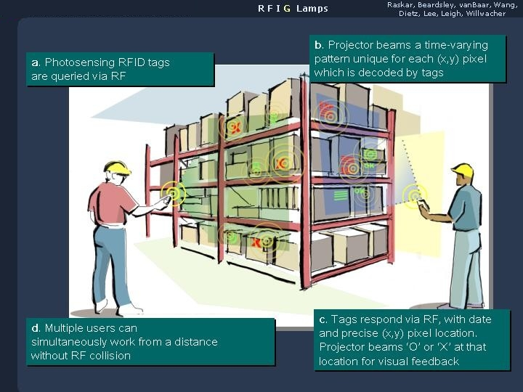
RFIG-Lamps(Raskar et. al [6])
Notes:
1)User points his projector.
2)Sends out RF signals
3)Tags under illumination which receive the RF signals respond back with information regarding its position and other info as required.
4)Every pixel transmitted by projector has different gray code. And the selected tags respond back reporting the gray code each receives.The projector then projects a “X” or a “O” on each tag.

Slide 17
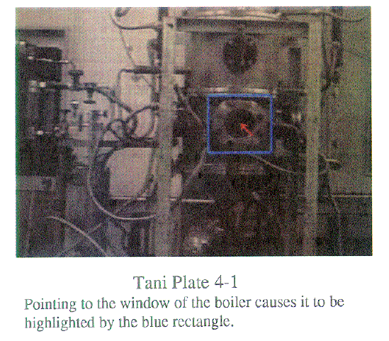
Video Interactions
- Tani et. al [7]used live video from fixed camera to interact with machines in a plant.

Slide 18
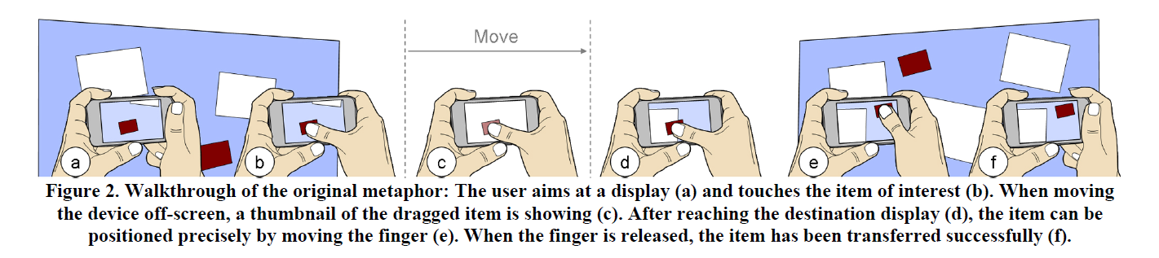
Touch Projector (Boring et. al [8])
-Interaction with live video on touch phone, to move items from one display to another.

Slide 19
Other Related Works
Spatial Memory Utilization :
- Cockburn et al [9]
-Using the table space around a laptop to assignto select different tasks: Unadorned desk(Hausen et. al [12])
Transparent Obstacles:
-Human Tracking through walls :- WiTrack,(Adib et. al [10])
-Looking through upper shells of complex 3D models:-
Pindat et. al[11]
Smart Home Control :
- Controlling through communication protocol using power lines: X10 [13]
-Control through smart phone applications : Control4[14]
-Control via Xbee transceivers : Peng et. al [15]

Slide 20
SuperVision-THE CONCEPT
Objects in the same room as user:
-User points at the object with a handheld projector.
-User presses a button on the projector to select the object.
-The system recognizes the object.
-The projector now projects the selected object’s controls around the object.
-The positions of the controls are fixed with respect to the real world, so on moving the projector, some controls can be viewed, others may get hidden.
-Using a cursor at the center of the projection, a control element can be selected, which introduces a corresponding action on the selected object.

Slide 21
SuperVision-THE CONCEPT
Objects In adjacent rooms:
- User points at a wall and moves a physical slider(on the projector) up.
- The projector display changes to show a hole in the wall
which becomes bigger as the slider is moved up.
- Through this virtual hole in the wall is visible a video of the adjacent room.
- Depending on where the “hole” on the wall is the part of the video that can be viewed, varies, to mimic the actual metaphor of looking through a wall.
- The projected cursor is placed on a desired object and select button is pressed.
- Again control elements appear on the video around the selected object, which can be selected as before.

Slide 22
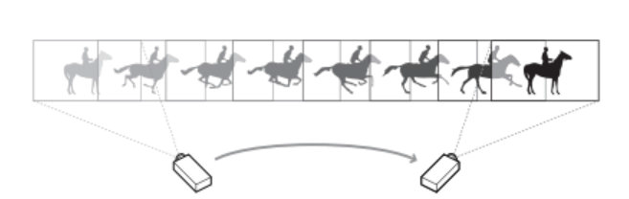
The Two Important Metaphors
The Spot Light Metaphor: The projector’s illumination acts like a spotlight which displays only certain parts of the virtual space, depending on where the projector is pointing. This metaphor is also known as the “peepHole interaction”.[16]

Slide 23
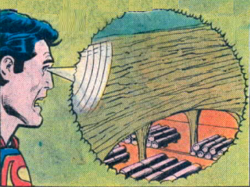
The Super Man Vision Metaphor: There has been an effort to realize superhuman powers in terms of “drilling” through a wall to visualize the scene behind it.

Slide 24
Implementation
The Implementation can be broken down into
- Tracking of the pointing device
- Prototype of the Pointing Device
- System Setup
- Software on the Host computer

Slide 25
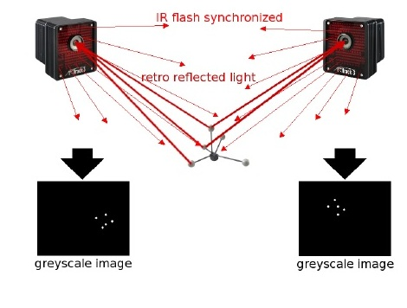
Tracking of Pointing Device
ART : Advanced Real-time Tracking System.

Slide 26
Tracking of Pointing Device
8 cameras set up which constantly give out IR flashes.
Markers/targets have retro-reflective material which reflect back the IR rays to the source( the respective cameras).
ART software analyses the reflected signal and calculates 6DOF information (position + orientation)

Slide 27
Tracking of Pointing Device
The body coordinates are converted into absolute coordinates of the room as
xroom = R.xbody +s
R is the rotation matrix, xbody is a vector in body coordinates. S is the position of the tracked body in room coordinates. xroom is the vector transformed into room coordinates.

Slide 28
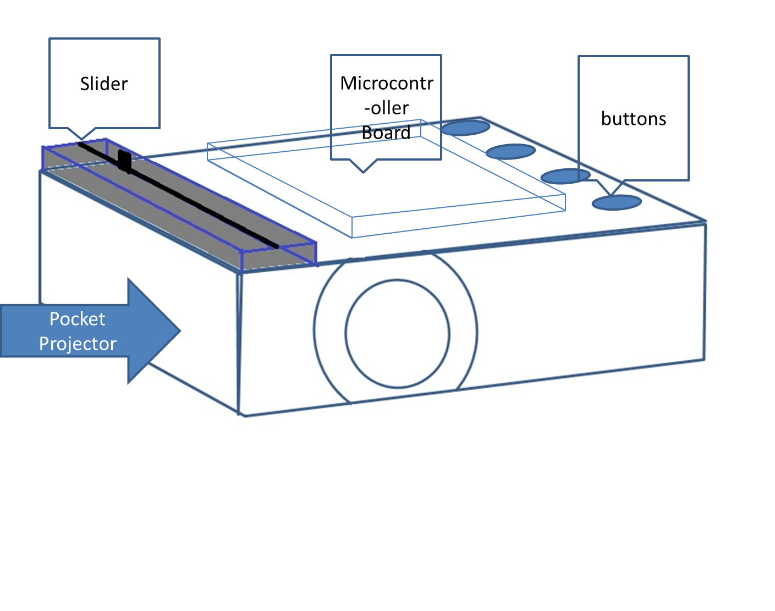
Prototype of Pointing Device
Projector Used: Philips Picopix 3610

Slide 29
The System Setup
Pointing device containing a hand-held projector
Computer host receives information from the pointing device wirelessly( XBEE)
Computer host receives 6DOF information from the ART server.
Computer host sends back visual information to the pointing device, through WIFI, which can be projected.
The computer is also connected to a camera which gives video feedback when we are visualizing the objects behind a wall.
This camera is pan and tilt capable, and is moved, and its direction is changed according to where we are pointing.

Slide 30
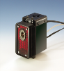


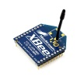
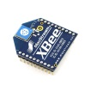
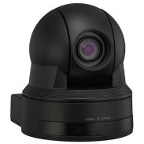
The System Setup
Projector with tracking target
ART tracking server
Projection screen info transferred over WIFI
IR cameras for tracking
Xbee transceiver
Host computer
Xbee transceiver
Pan + tilt camera
Placed in adjacent room

Slide 31
Software on the Host Computer
Software developed using C++ in Qt.
Client program to receive 6DOF information from the ART server
Every object is modeled either as rectangles on the wall, or as rectangles on the floor. Database of objects created, with absolute coordinates of every rectangle
Pointing direction is calculated using the rotation matrix provided by the tracker.
Intersection of pointing direction with predefined rectangles is calculated to identify objects.

Slide 32
Software on the Host Computer
Object selection is registered when user presses button on the pointer. This information is transferred to the computer through XBee radio communication
Depending on objects identified, suitable visual graphics is generated using Qt, which is transferred to the hand-held projector using WIFI.
When user moves slider on the pointer, the host computer generates graphics, to mimic looking through a wall, and shows the video captured from the camera.
In this mode, the camera is panned or tilted by passing Serial (RS-232) commands from the computer, depending on where the user points.

Slide 33
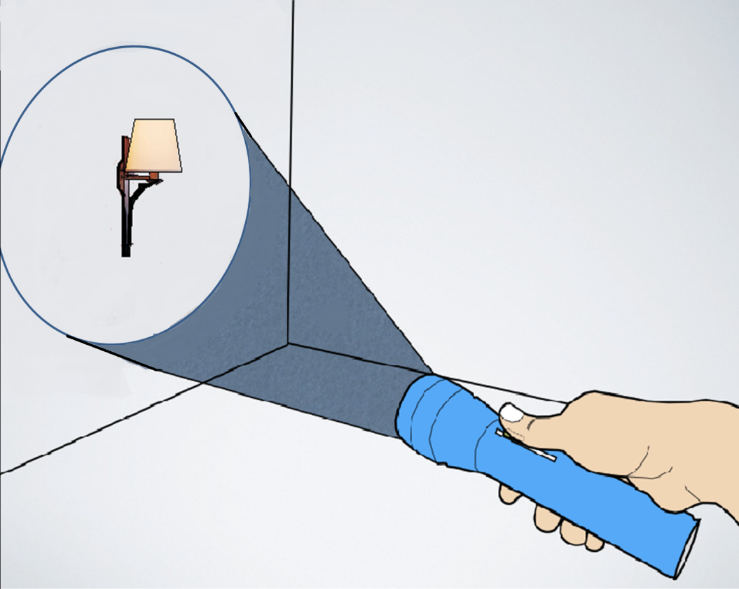
Example Interaction
User Points at the lamp on the Wall

Slide 34
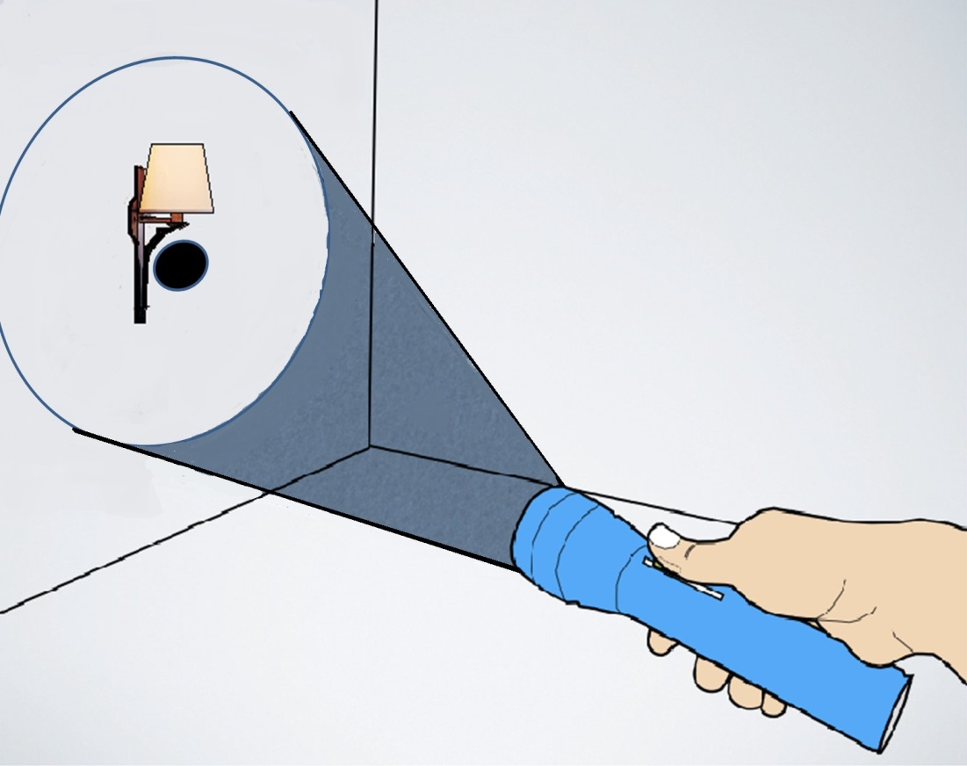
Example Interaction
A black circular “cursor” appears at the center of the projection
User aims the cursor near to the lamp and presses select button

Slide 35
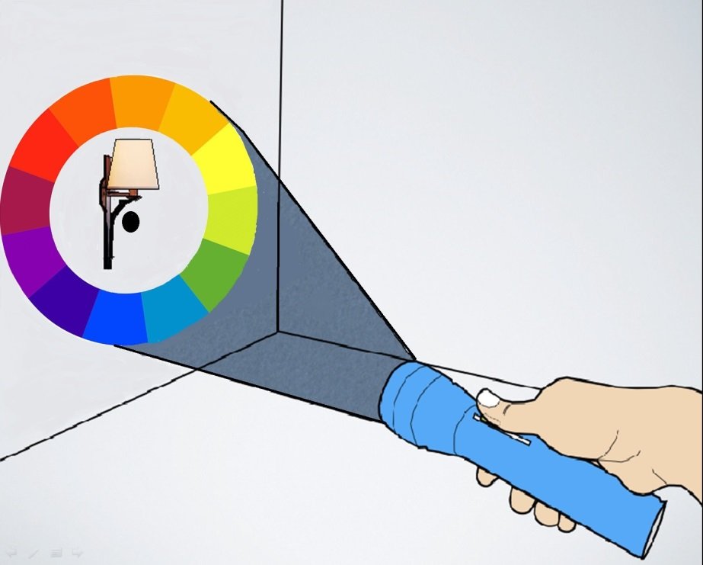
Example Interaction
As the lamp is selected, a color wheel is projected around the lamp

Slide 36
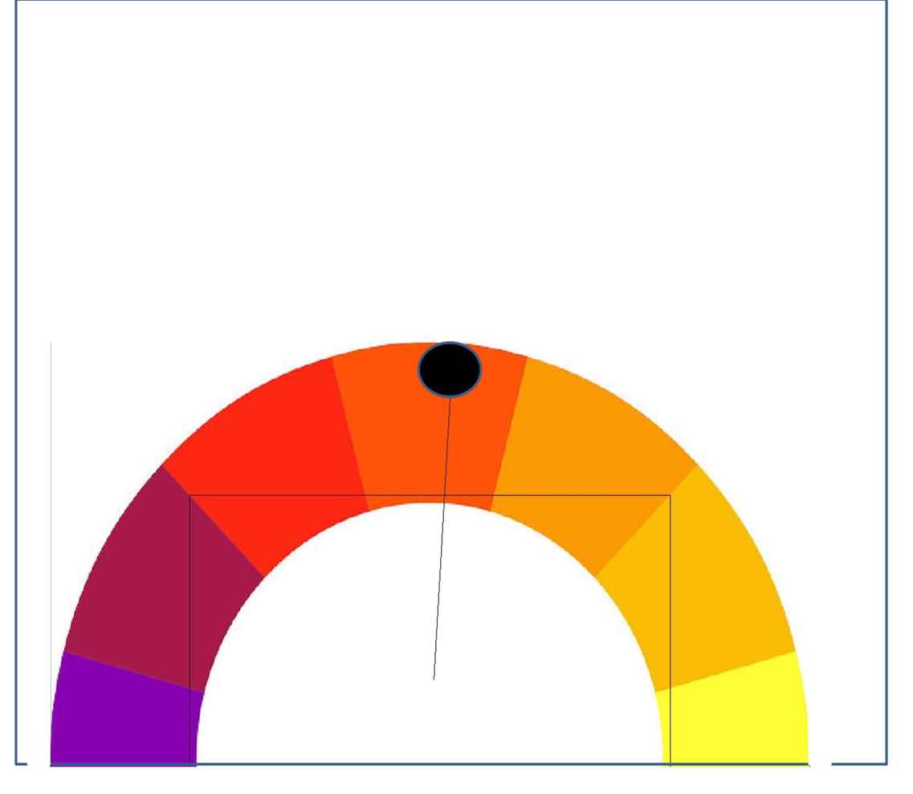
Example Interaction
User can now press select and drag the projector to the desired color to apply that color to the lamp.
The color wheel stays fixed in its real world position while the projected area moves.
The blue rectangle represents the projected area. The black circle at the center. As the center of projection is moved across the orange, the orange color gets selected for the lamp.

Slide 37
Example Applications
Light Control: Switch on/off lights, control the brightness and set the color of lamps by pointing and interacting.

Slide 38
Example Applications
Robotic Vacuum Cleaner control: Make a vacuum cleaner follow a path, by sketching it virtually on the floor.

Slide 39
Example Applications
Heater/ AC control: Select and Set the temperature of a heater, or an air-conditioner by pointing at it.

Slide 40
Example Applications
Controlling the kitchen stove: Point and set parameters on a kitchen stove from a different room and monitor the cooking.

Slide 41
Example Applications
Monitoring the Baby : Point and keep an eye over the baby as it plays in its nursery.

Slide 42
Future Work
Last stage of implementation using video feedback from camera and integrating interactions with lamps and vacuum cleaners.
User study to validate the prototype and to analyze the changes required.
Publishing the results in the form of a paper

Slide 43
Conclusion
SuperVision provides a new interaction method to control distal objects.
It utilizes the user’s capability to point at objects that are not in the same room.
It implements the two major metaphors of “peephole navigation” and “Super man vision”
It makes use of a handhelf projector pointing device.

Slide 44
References
[1] http://home.howstuffworks.com/appliances/all-in-one-products/universal-remotes.htm
[2] ShwetakN. Patel and Gregory D. Abowd. A 2-way laser-assisted selection scheme for handhelds in a physical environment
[3] Colin Swindells, Kori M. Inkpen, John C. Dill, and Melanie Tory. That one there! pointing to establish device identity. In Proceedings of the 15th Annual ACM Symposium on User Interface Software and Technology, UIST '02, pages 151{160, New York, NY, USA, 2002. ACM.
[4] Andrew Wilson and Steven Shafer. Xwand: Ui for intelligent spaces. In Proceedings of the SIGCHI Conference on Human Factors in Computing Systems, CHI '03, pages 545{552, New York, NY, USA, 2003. ACM.

Slide 45
References
[5] Dominik Schmidt, David Molyneaux, and Xiang Cao. Picontrol: Using a handheld projector for direct control of physical devices through visible light. In Proceedings of the 25th Annual ACM Symposium on User
[6] Ramesh Raskar, Paul Beardsley, Jeroen van Baar, Yao Wang, Paul Dietz, Johnny Lee, Darren Leigh, and Thomas Willwacher. Rfig lamps: Inter- acting with a self-describing world via photosensing wireless tags and projectors. In ACM SIGGRAPH 2004 Papers, SIGGRAPH '04, pages 406{415, New York, NY, USA, 2004. ACM.
[7] Tani, M., Yamaashi, K., Tanikoshi, K., Futakawa, M. and Tanifuji, S. (1992). Object-oriented video: interaction with real-world objects through live video. Proc. CHI 1992, 593–598.

Slide 46
REFERENCES
[8]Sebastian Boring, Dominikus Baur, Andreas Butz, Sean Gustafson, and Patrick Baudisch. 2010. Touch projector: mobile interaction through video. In Proceedings of the SIGCHI Conference on Human Factors in Computing Systems (CHI '10). ACM, New York, NY, USA, 2287-2296.
[9] Andy Cockburn and Bruce McKenzie. 2002. Evaluating the effectiveness of spatial memory in 2D and 3D physical and virtual environments. In Proceedings of the SIGCHI Conference on Human Factors in Computing Systems (CHI '02). ACM, New York,
[10] WiTrack :Through-Wall 3D Tracking Using Body Radio Reflections, Fadel Adib, Zachary Kabelac, Dina Katabi, Robert C. Miller Usenix NSDI'14, Seattle, WA, April 2014
[11] Pindat, Cyprien and Pietriga, Emmanuel and Chapuis, Olivier and Puech, Claude: Drilling into Complex 3D Models with Gimlenses,October, ACM 2013

Slide 47
REFERENCES
[12] The Unadorned Desk: Exploiting the Physical Space around a Display as an Input Canvas: Doris Hausen and Sebastian Boring and Saul Greenberg, INTERACT 2013
[13]http://en.wikipedia.org/wiki/X10_(industry_standard)
[14] http://www.control4.com/
[15] Seong Peng Lim; Yeap, Gik Hong, "Centralised Smart Home Control System via XBee transceivers," Humanities, Science and Engineering (CHUSER), 2011 IEEE Colloquium on , vol., no., pp.327,330, 5-6 Dec. 2011 doi: 10.1109/CHUSER.2011.6163743
[16] Xiang Cao, Jacky Jie Li, and Ravin Balakrishnan. 2008. Peephole pointing: modeling acquisition of dynamically revealed targets. In Proceedings of the SIGCHI Conference on Human Factors in Computing Systems (CHI '08). ACM, New York, NY, USA, 1699-1708
[17] https://www.sparkfun.com/datasheets/Wireless/Zigbee/XBee-Datasheet.pdf
[18] http://en.wikipedia.org/wiki/VISCA_Protocol

